Slide 1

AUSTRALIA
Australia is the 6th Largest country in the world. It is a new country, proclaimed in 1788, which makes it only 237 years old. It has a diverse culture as majority of the population increase is due to migration. International students contribute significantly towards Australia’s Economy.

Slide 2

AGENDA
INTRODUCTION
Journey-personal experience
Visas
Learnings
Wish I had known

Slide 3

Rajvi Gajra
Education India: Completed Schooling.
Education: Bachelor of Business- Major Accounting.
University: 50% from Deakin University; 50% from University of Tasmania.
Residence in India: Valsad, Gujarat.
Current Residence: Hobart, Tasmania.
Employment: Graduate Accountant at Hobart City Mission.

Slide 4

Journey
Moved to Australia in October 2017.
Studied at Deakin University for 2 years; completed 1.5 years of my degree.
Suggestion to move to Tasmania and complete the rest of my study from there so I can get PR (Permanent Residency). Reginal State- Visa-190.
Completed the course from University of Tasmania.
The rules change every 6 months or at least Every year. So to reach the minimum requirement at the time of completion. It took me 3 years to finally apply for the PR. This includes Changing of Jobs, Changing of Agents, Requesting specific work arrangements to meet the PR criteria etc.
Current stage- I have now applied for Visa-190 and got the PR approval- still maintaining the moral obligation to live 2 years after the visa approval stage.

Slide 5
SELECTING a VISA
Every case is different

Slide 6
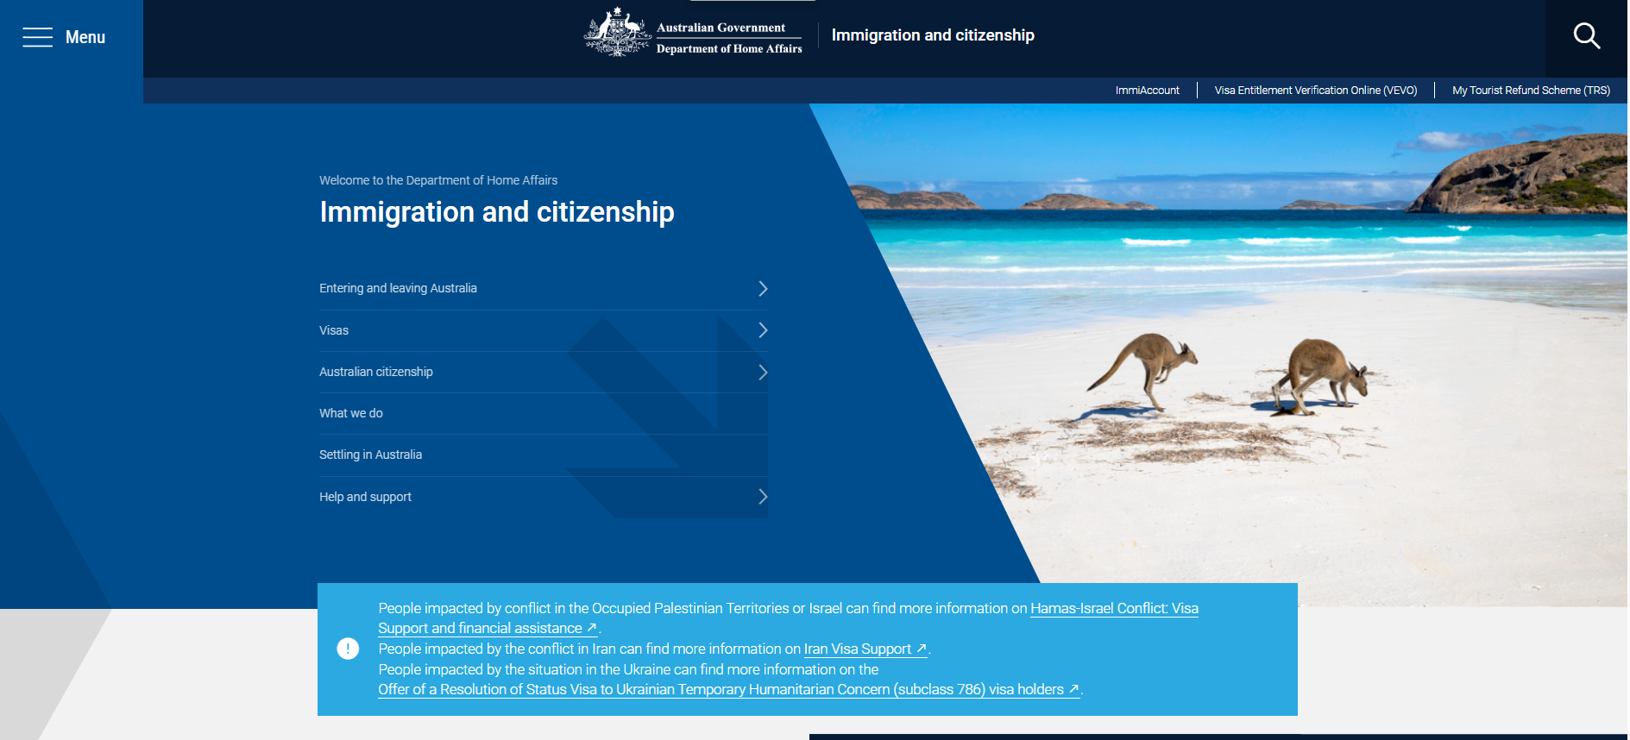
Do your homework yourself
Make sure you are looking at the right place.
Immigration and citizenship
https://immi.homeaffairs.gov.au/home
General visas:
(I have lodged till now.)
Student Visa – 500
Temporary Graduate (TR) Visa- 485
Skilled Nomination Visa (PR) - 190
When you have a gap in between visas you will need to apply for Bridging visas depending on the condition- there are 4 types that we generally, use.
Bridging A , B or C, E.

Slide 7
learnings
Take advices but do your Homework before implementing.
Rely on your own research first before going to an agent or seeking any help.
100 questions are better than 1 BIG Sorry.
Having a clear direction is very important.
Wish I had known!
Wish I had known about the BOSS group earlier, it might have helped me.
Wish I had researched more about Visa and University terms and conditions, I would have reached my goals earlier in Life.

Slide 8
Pro & Cons
You will learn Life Skills at young age.
Worldwide exposure to opportunities.
Strong Currency.
Exposure to diverse cultures.
Internationally recognized degree in majority of the countries.
Independence- Choice of Lifestyle.
Latest technology.
Reinvent yourself – regardless of your background.
Very Optimistic environment.
Well resourced country.
Systematic process for everything.
Learn all basic life skills Example: Cooking, Washing, Cleaning.
Far away from the Family.
NO MAIDS.
You have to be willing to LEARN everything and do everything yourself.
Lack of Emotional support due to lack of family/friends.
Mom can’t cook for you when you have exams.
Worring about Visas to move cross countries.
Always need to have a valid visa to stay or they can Deport you.
Expensive to visit Home.
Work at food store or retail etc. wherever you get accepted to start basic earning while studying. (No job is Big or Small here.)

Slide 9

THANK YOU
Rajvi Gajra

