Slide 1



SHREE KUTCHI BHANUSHALI SEVA SAMAJ TRUST
rachit
PARAM PUJYA SANT SHREE ODHAVRAM EDUCATION FOUNDATION
BHANUSHALI OVERSEAS SUPPORT SYSTEM

Slide 2


Topics
▸ Introduction
▸ BOSS Process
▸ Results till 2025
▸ Key Activities
▸ Communication
▸ Broader Vision of BOSS
▸ Mission for BOSS
© 2020 Bhanusamaj.org
2

Slide 3


Introduction
BOSS is an end to end Support System for students & professionals planningto study& workabroad. We achieve this bybuildingstrongnetwork of communitymembers livingin Indiaand abroad.
BOSS Timeline
2018
2019
2020
2025
18th March 2018,
First presentation
1st June 2019, second BOSS Seminar
19 July 2020, First IBS –Get Together
20th July 2025, 8th BOSS Webinar
24 J une 2018,
First BOSS Seminar
26 J uly 2020,
third BOSS Virtual Webinar
All Student Seminar
For Students By Students
3

Slide 4


Doubts
“ During PLANNING

Slide 5





Doubts contd…
WHITE STUDYING
▸ Bank Account
▸ Accommodation
▸ Transportation
▸ Part Time Job
▸ Indian families known?
▸ How much money should I carry?
AFTER STUDYING
▸ Referral in a company?
▸ How to find a Job?
▸ Do I need work Visa?
▸ How do I settle in the country?
▸ How do I apply for GC/PR
▸ Can I start my business?
© 2022 Bhanusamaj.org
5

Slide 6
BOSS Process
Step 1
Bhanusamaj collects data of all the students going abroadfor studies.
Bhanusamaj engages experts to guide students & organizes seminars.
Bhanusamaj sends list of students to APCs to start doingfollow up.
APCs collect more information from students, talk to parents in India & add students to email group
APCs connect students to alumni of the respective university and host
families inthat city.
APC will stay in touch till graduation & also help for jobreferrals / connections
Step 2
Step 3
Step 4
Step 5
Step 6
© 2022 Bhanusamaj.org
6

Slide 7


“
BOSS – India & in Abroad
▸Continuous communication with students and
parents
▸Manage Email Group for broadcasting message
▸Maintain Bhanushalis living abroadfull database
▸Connect alumni with new students in that University
▸Connect host families with new students in that City
▸Help student get Jobs by referrals and alumni connect

Slide 8






BOSS Annual Activities
BOSS Annual Seminar
International Bhanushali Sammelan (IBS)
Country Spec ific Webinars & Resources
All Hands Meeting of APCs of all c ountries
Enc ourage And Inc rease
Awareness of Study Abroad
Professional Help

Slide 9

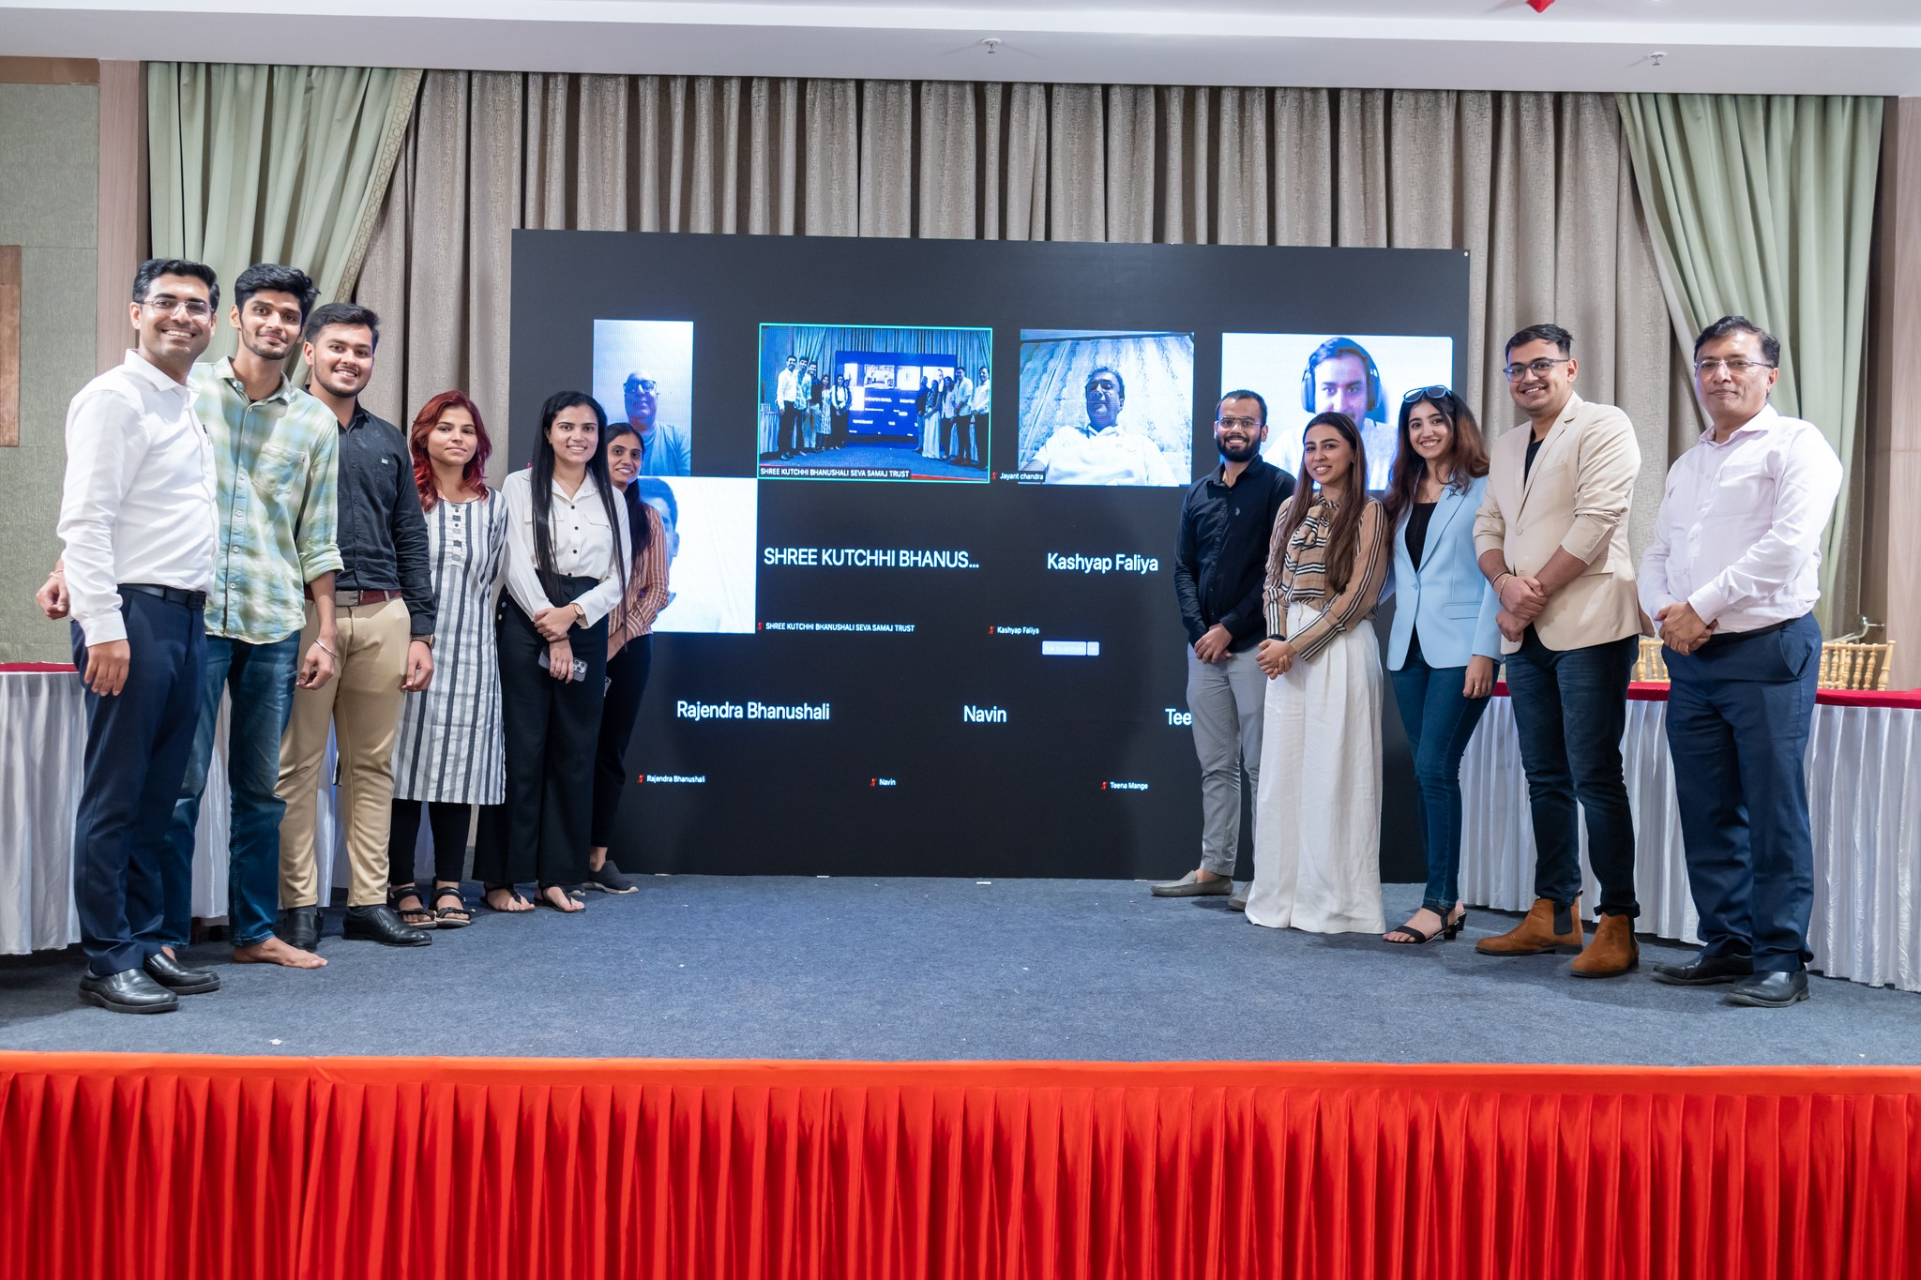
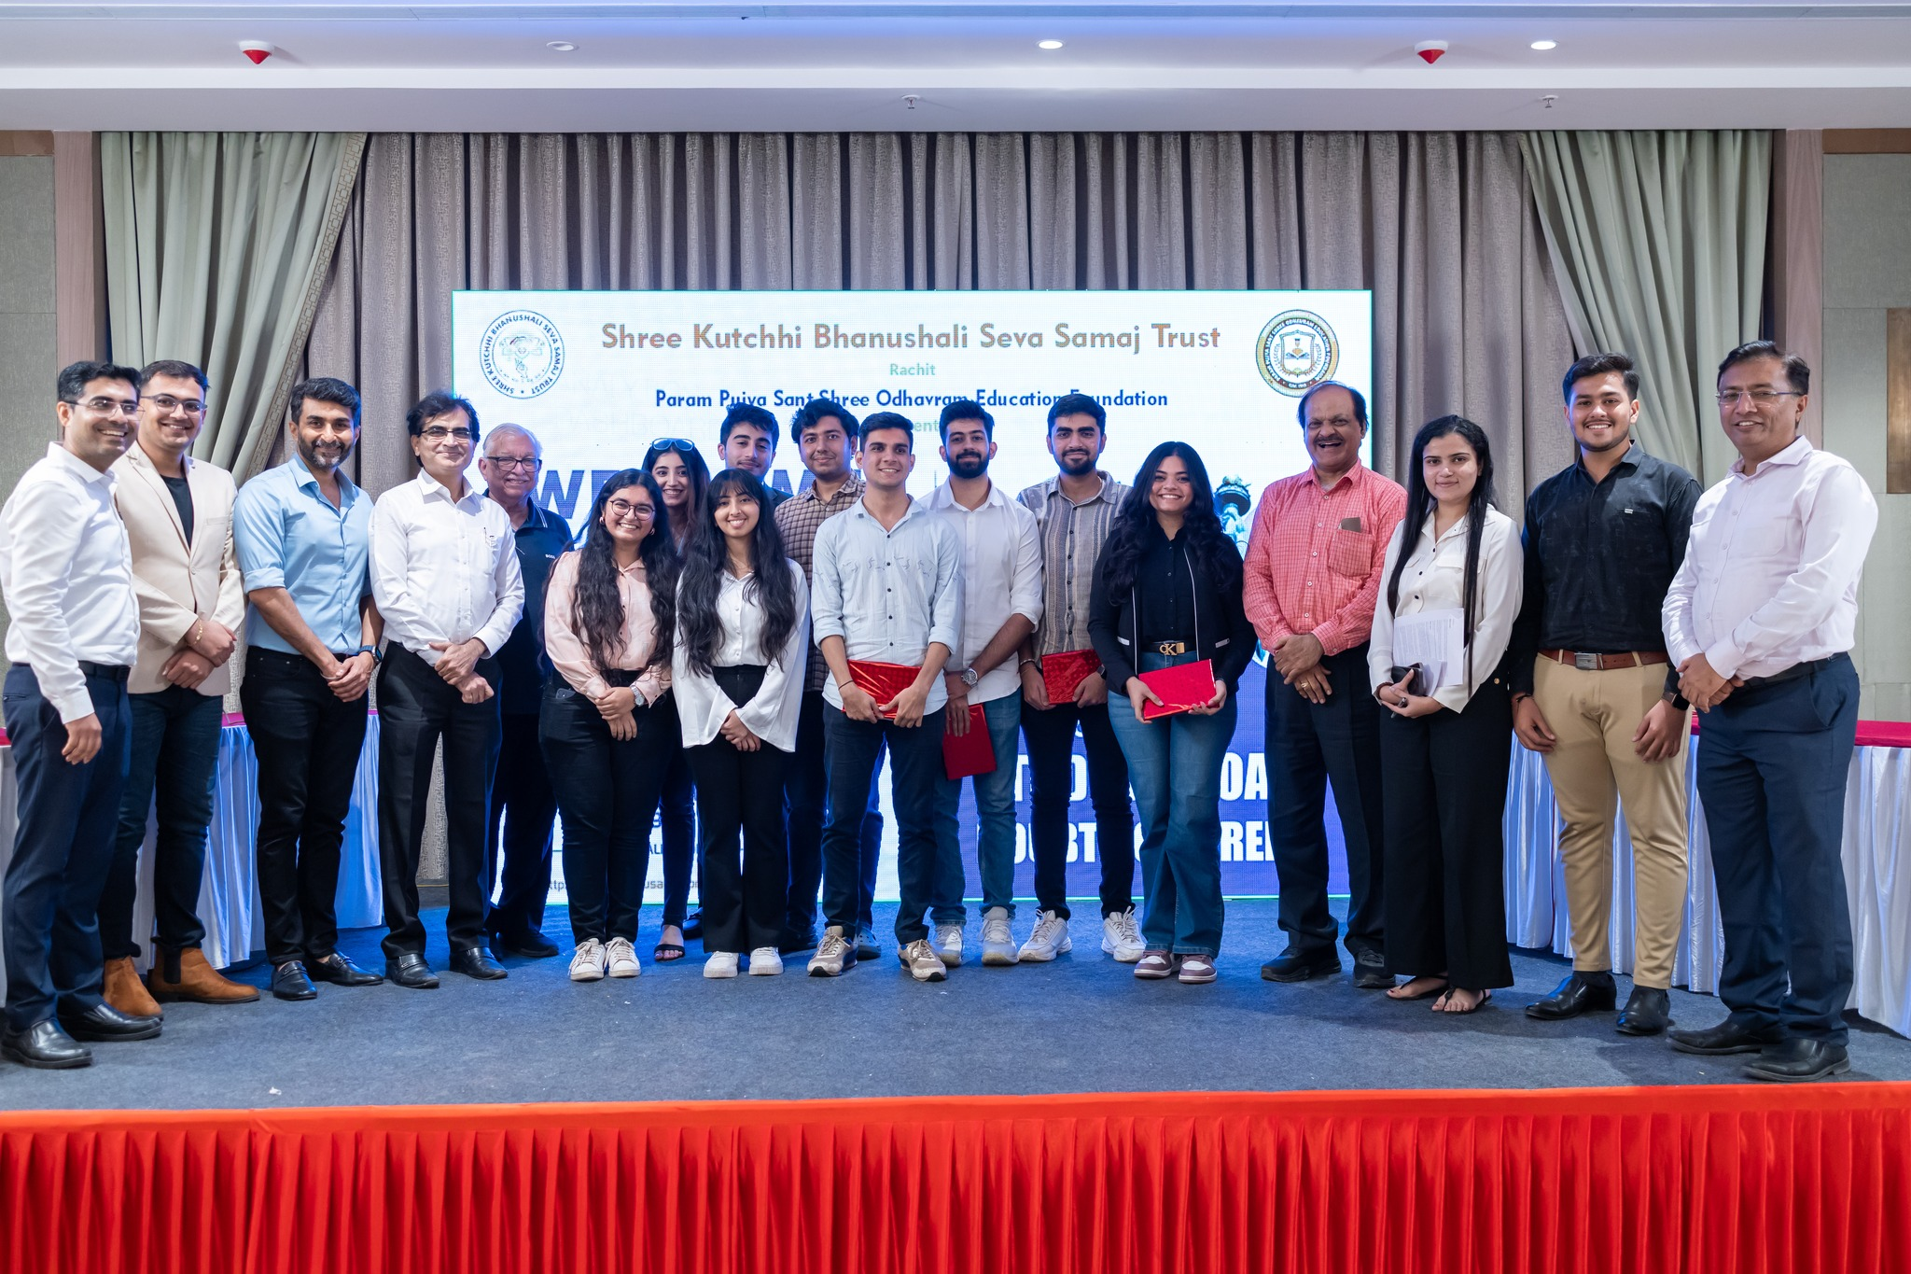
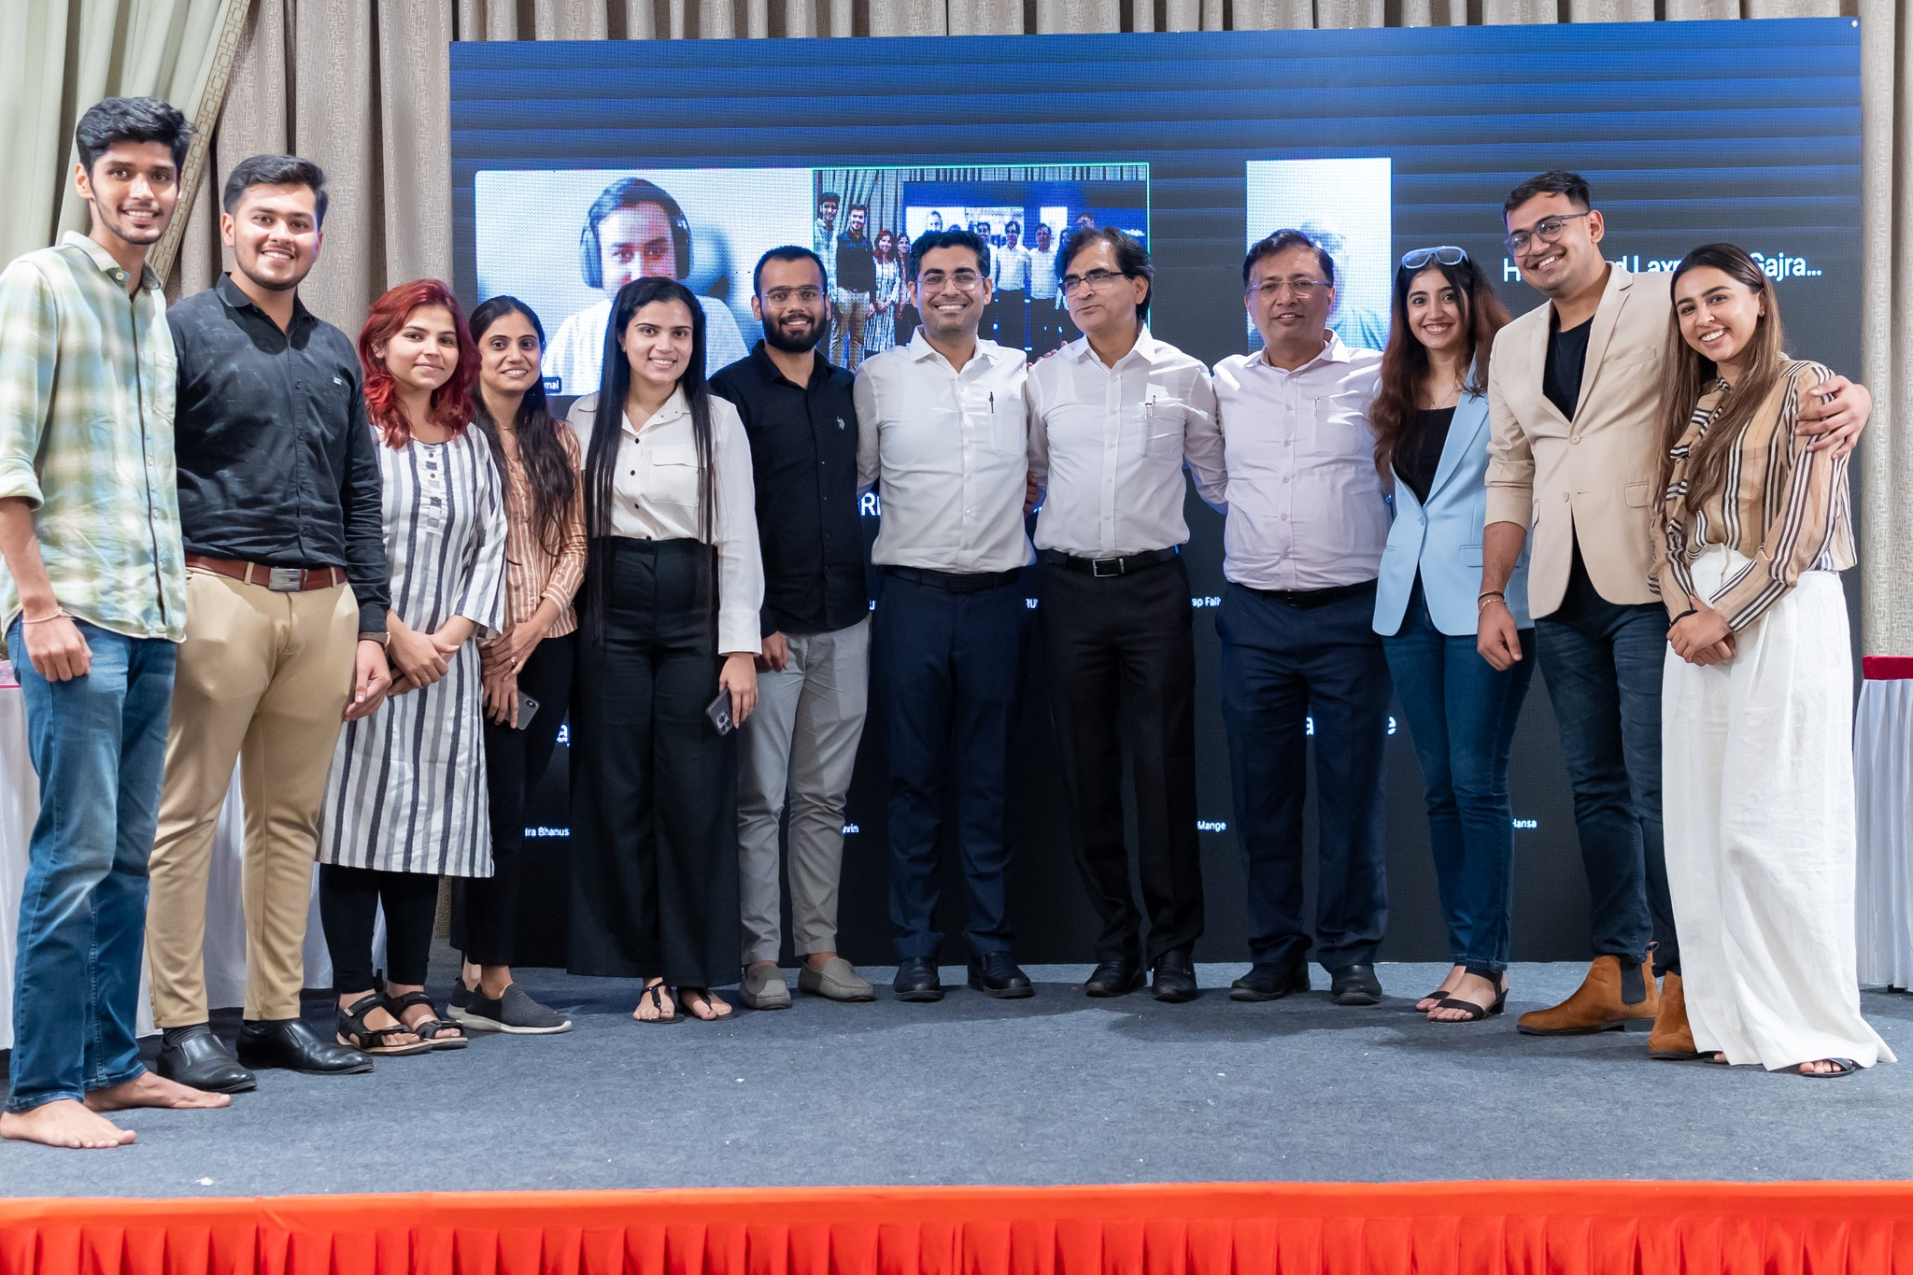
BOSS 7 Event Pictures

Slide 10

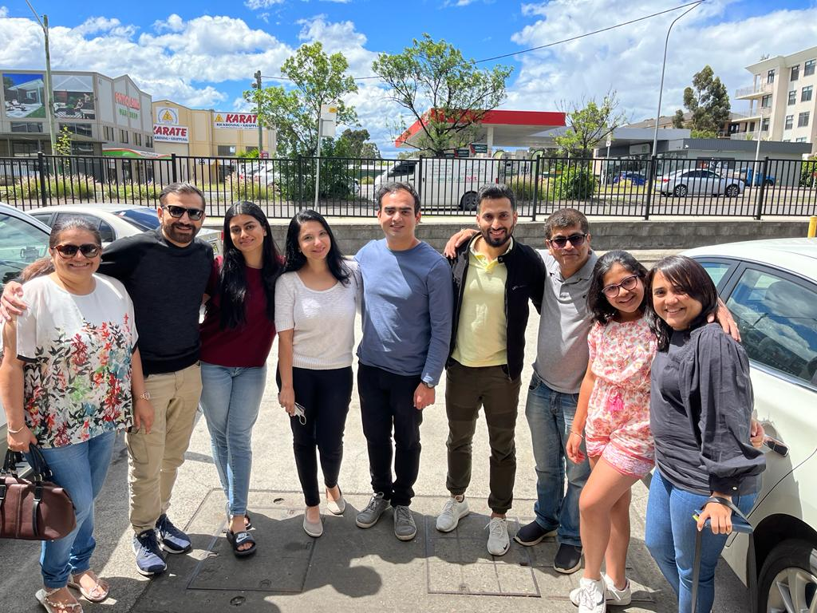
Australia Meet

Slide 11
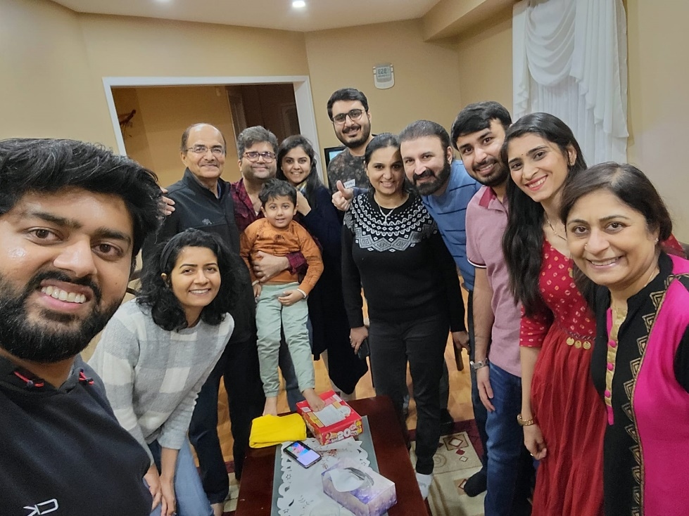
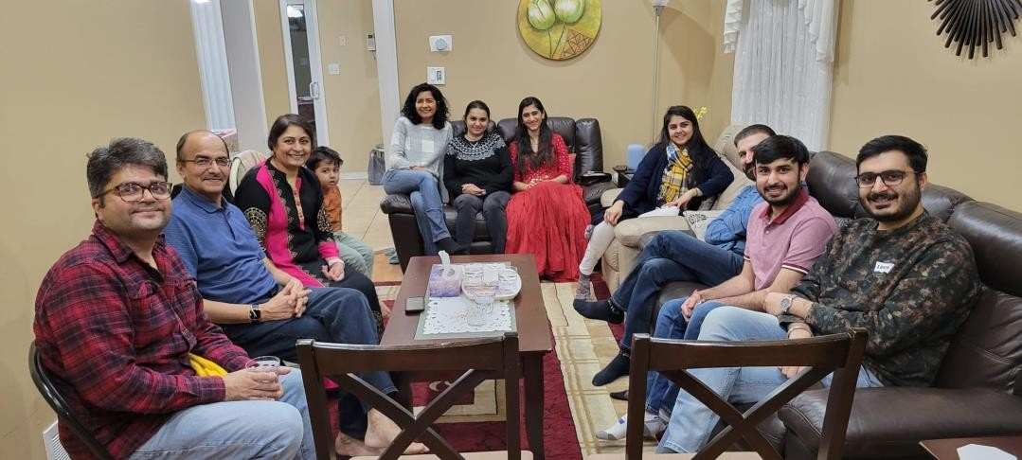
Canada Meet Up

Slide 12
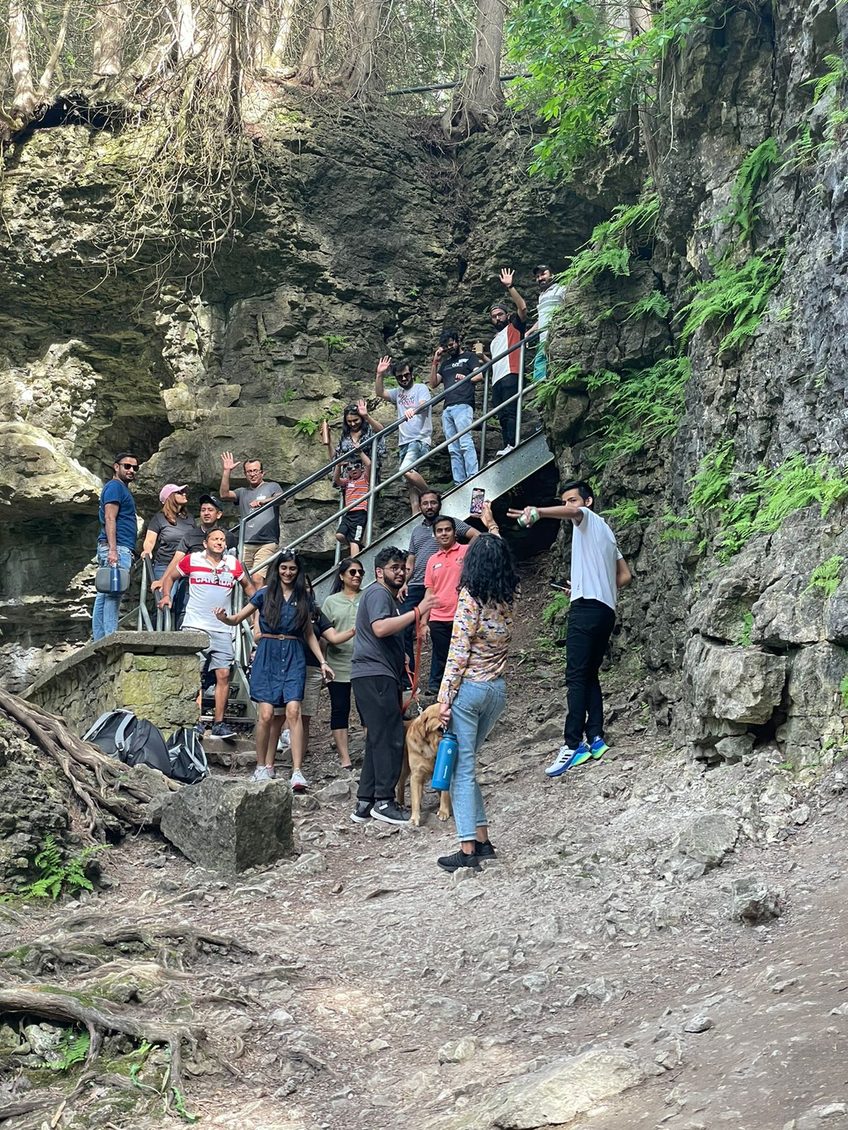
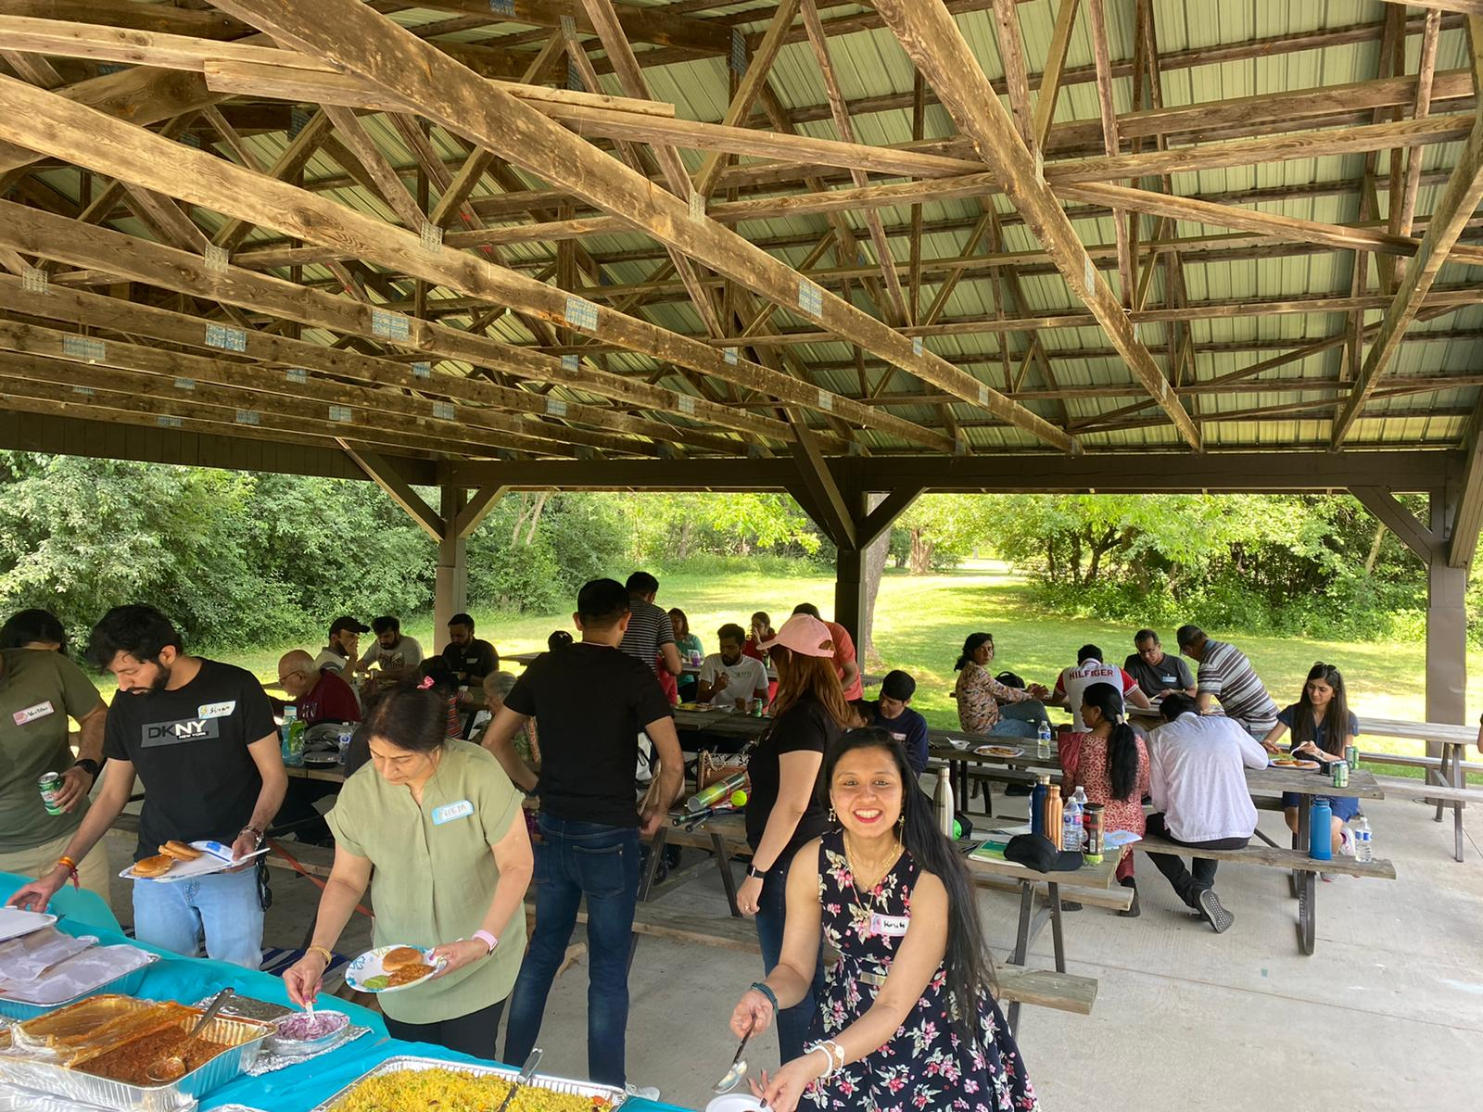
Canada Picnic

Slide 13
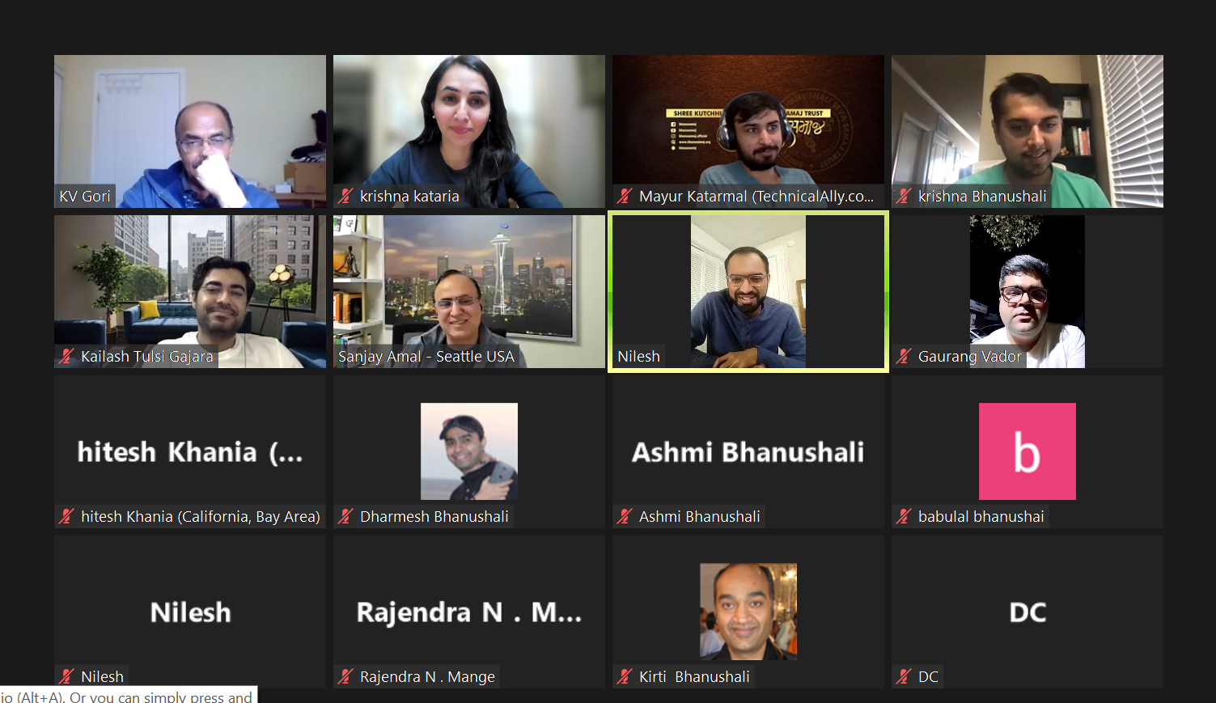
BOSS Sync – Up North America Bhanushali Samaj team (NABS)

Slide 14
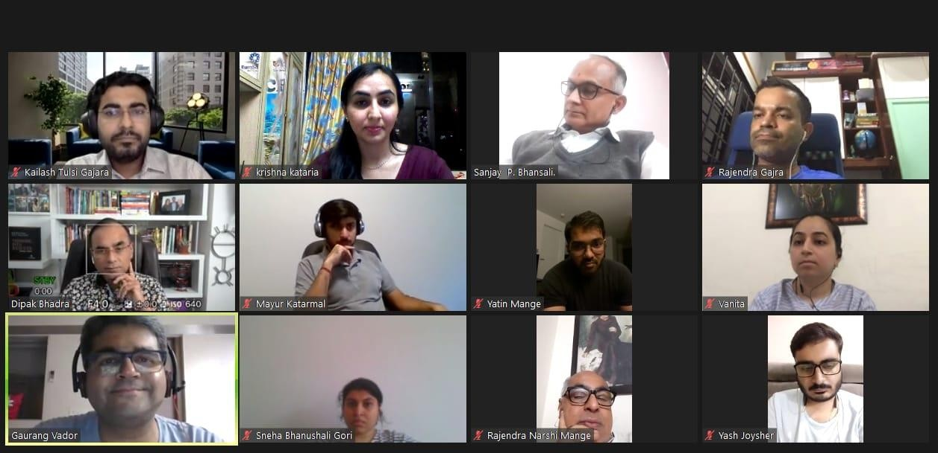
APC Meeting

Slide 15
Where has BOSS reached in 2025..
Data of 350+ Bhanushalis in Abroad...
Garnered 3,500 Views on
YouTube
213 student members on groups.io and 55 discussions around abroad study
2 WhatsApp groups –
450+ Members
60+ Students benefited in last 4 years
30+ renowned experts in the contact..
17 + countries Abroad Program Coordinators

Slide 16
Communication
Student connect & get doubts cleared
▸ Email Groups
▹ https://groups.io/g/boss
▹ https://groups.io/g/bhanu-overseas
▸ WhatsApp Groups (3)
▸ LinkedIn Groups
▸ www.facebook.com/bhanusamaj.boss
▸ Website Update: www.bhanusamaj.org/boss
Students can connect with alumni, host families etc through these platforms and get their queries resolved.

Slide 17




BROADER VISION
Expanding the scope of BOSS & NABS

Slide 18
Mission for BOSS
Conduct Country Specific Seminars and Career Sessions
Increase Participation In Seminars, Sammelans and BOSS events
Create Success Stories with More Bhanushali Students and Professionals abroad
Strengthen Connect and Network With Bhanushalis In various countries
Increase Awareness of BOSS Activities
Finalize Overseas Database Tooland Format in Coordination with APCs

Slide 19


THANK YOU!
Any questions?
Connec t with us:
▸ www.bhanusamaj.org/boss
▸ www.facebook.com/bhanusamaj.boss
▸ https://groups.io/g/boss
▸ education@bhanusamaj.org
Call us:
▸ Kailash Gajara ( 7506290555)
▸ GaurangVador (8291430902)
▸ Kashyap Fuliya (88507 94905)
▸ Khushi Mange ( 9167748331)
Jai Odhavram
22

